Slide 1
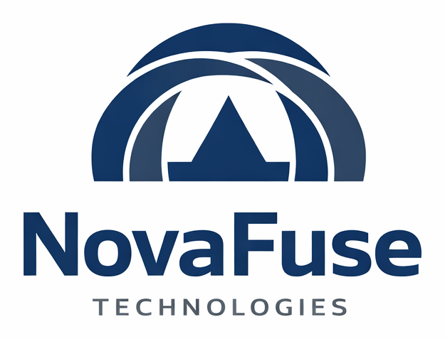
EXECUTIVE BRIEF
Before You Scale AI,
Prove the Value.
One workflow. Two paths. Clear evidence. Measurable economics.
NovaFuse helps organizations determine whether an AI-driven business action creates more value than it costs - before a larger rollout.
AI VALUE PROOF
Digital Capability Engineering

Slide 2
THE BUSINESS PROBLEM
02
AI adoption is widespread. Enterprise value is not.
5%
60%
39%
of companies generate AI value at scale
report little material value despite investment
report enterprise-level EBIT impact
The technology may be real. The price-to-value question is still unresolved.
NOVAFUSE TECHNOLOGIES
Sources: BCG, The Widening AI Value Gap (2025); McKinsey, The State of AI (2025)

Slide 3
THE MEASUREMENT GAP
03
Usage is not the same as value.
What companies often count
What leaders need to know
- Tokens consumed
- Did the right action happen?
- Employees using AI
- Was a bad action stopped?
- Time saved
- Was useful work preserved?
- Tasks completed
- Can the result be explained?
- Model accuracy
- Did the value exceed the cost?
NOVAFUSE TECHNOLOGIES

Slide 4
ONE EXAMPLE
04
An automated system starts a payment.
The action is simple. The business questions are not.
INVOICE
AUTOMATION
PAYMENT
REAL EFFECT
A payment request enters the workflow
>
An AI agent, API, or workflow recommends action
>
Money is about to move
>
Cash, records, and obligations change
Wrong amount | Duplicate invoice | Unauthorized vendor | Missing approval | Valid payment blocked
Illustrative workflow - not a claim of customer deployment
NOVAFUSE TECHNOLOGIES

Slide 5
THE CURRENT PATH
05
The payment completes. The questions come afterward.
REQUEST
AI OUTPUT
PAYMENT
LOGS
>
>
>
Invoice and context
Approve or reject
Action completes
People investigate later
The model may be accurate. The workflow may still produce the wrong business outcome.
Monitoring tells you what happened. It does not always prevent the action that should not happen.
NOVAFUSE TECHNOLOGIES

Slide 6
THE NOVAFUSE PATH
06
Keep the systems. Add a decision point before the effect.
CHECK
REQUEST
AI OUTPUT
Identity, amount, vendor, approval, evidence
DECISION
RECORD
Same invoice and workflow
>
Same model or automation
>
>
Go forward or stop
>
What happened, why, and what it cost
The control becomes part of the action - not an explanation added after it.
NovaFuse does not require the company to replace its AI, payment platform, accounting system, or workflow first.
NOVAFUSE TECHNOLOGIES

Slide 7
ACTION-LEVEL ECONOMICS
07
Measure the result where the money moves.
VALUE CREATED
COST ADDED
Mistakes stopped
-
Setup and connection
Good actions preserved
Checks and evaluation
Time and review saved
Evidence and operation
NET ECONOMIC BENEFIT
NOVAFUSE TECHNOLOGIES

Slide 8
THE FIRST ENGAGEMENT
08
Prove one workflow before a wider rollout.
1
2
3
4
5
Choose
Define
Run
Inspect
Decide
One important AI-driven action
What should and should not happen
The current path and the controlled path
Decisions, outcomes, and evidence
Whether the value justifies adoption
No migration-first project. No enterprise-wide promise. One bounded economic test.
A Proof Run proves only the workflow, conditions, environment, and evidence path included in its scope.
NOVAFUSE TECHNOLOGIES

Slide 9
EVIDENCE BEFORE ASSERTION
09
The work already exists at several levels.
01
02
03
04
WORKING SOFTWARE
LIVE CLOUD TESTS
PUBLIC PAPERS
REFERENCE CODE
Implemented systems and bounded runtime behavior
Google Cloud runs with inspectable evidence
Specifications, reports, and stated claim boundaries
Public repositories and released implementations
Evidence rule: a test supports only what was tested, under the conditions stated.
Reference implementations and proposed uses are not presented as customer deployments.
NOVAFUSE TECHNOLOGIES
Public evidence: novafuse.tech/evidence.html | github.com/Dartan1983

Slide 10
THE ARCHITECTURE BEHIND THE EXAMPLE
10
One payment reveals a much larger capability system.
Attach to the workflow
NIRA
State what must be true
ERIL / ERI / CERI
Check identity and authority
NovaFuse ID
Control whether the action proceeds
Cyber-Safety / G-Tx
Produce proof and protected evaluation
NovaVault-X
Measure value and distribute economics
NovaPay / Cloud Capable
The payment is the doorway - not the boundary of NovaFuse.
NOVAFUSE TECHNOLOGIES

Slide 11
THE ASK
Bring us one AI-driven workflow
where the cost is real and the value is still uncertain.
We will help define the action, run both paths, inspect the evidence, and measure whether the added capability creates more value than it costs.
CHOOSE AN ACTION. RUN THE TEST. SEE THE MONEY.
contact@novafuse.tech
NovaFuse Technologies | Digital Capability Engineering

